Slide 1
TECH PEOPLE IN AFRICA
TOP TECH PEOPLE IN BENIN,LIBYA & NIGERIA

Slide 2
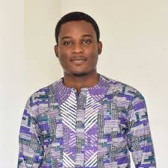
ULRICH SOSSOU
His current age 24 years.
Born in Benin
Founder TAKITIZ web agency.
Co-founder Flyerco.
Co-founder TEKXL.

Slide 3

JOANE SETANGINI
26 years old.
CEO Mboni.
Co-founder KhulaTech.
Developed Apps like Guna & Skrach.
Born in Benin.

Slide 4
STEVE NKASHAMA,AXEL PEYRIERE & MATHIEU FRUCTUEX
Founders of Cariwoso.
Benin Citizens.

Slide 5
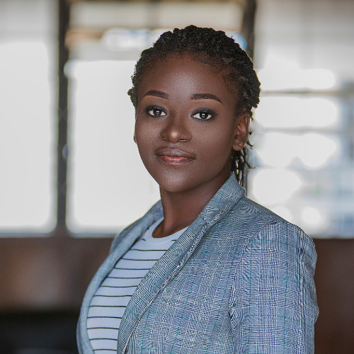
DR.VERA ARIELLA AHOUANSOU
23 years old.
Born in Benin.
Founder and CEO KEA Medicals.

Slide 6
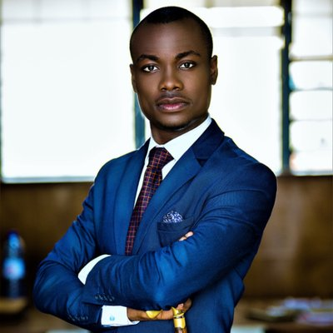
VITAL SOUNOUVOU
Founder Exportunity.Net
Graduate in Telecommunications and Software Engineering.
Born in Benin.

Slide 7
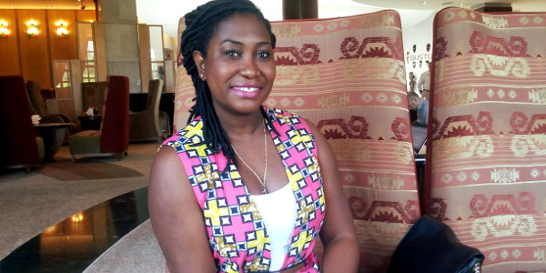
CONSUELO DOUGAN CHAFFER
Founder & General Manager EG Galleria
Financial Analyst.
Procurement Service Analyst.
Guinean

Slide 8
OMAR,FORES YOUNIS
Co-founders Lisan “language”
Libya citizens

Slide 9
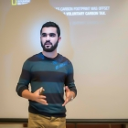
MAHMOUD,ABDULRHIM,AIHAM,AYMEN
Co-founders Sinbad App.
Libya citizens.

Slide 10
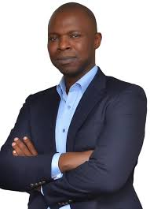
SIM SHAGAYA
Founder Konga.
Founded Konga in 2012.
Nigerian citizen.

Slide 11
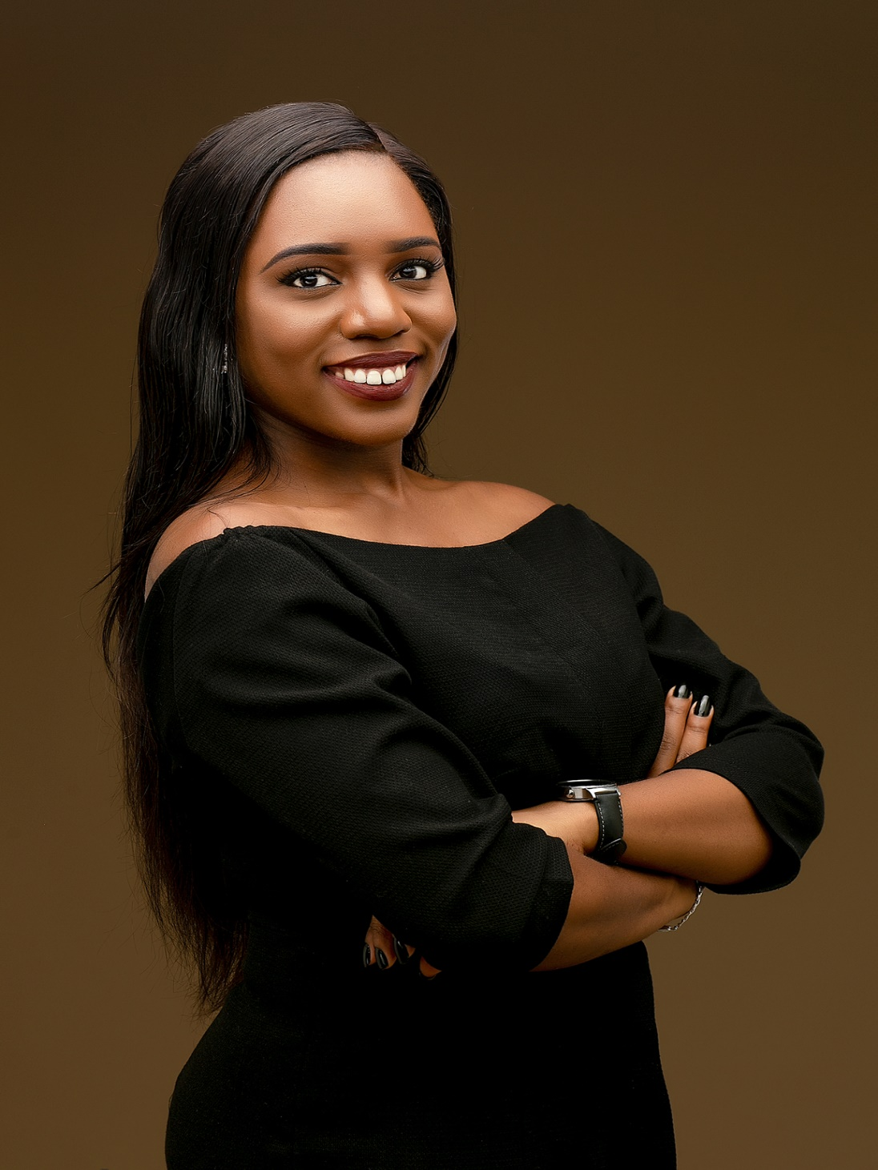
ANNA EKELEDO
Executive Director Afri Labs.
Nigerian citizen .

